Slide 1
CSS - Grid
Камилджанов Дидар

Slide 3


Slide 4
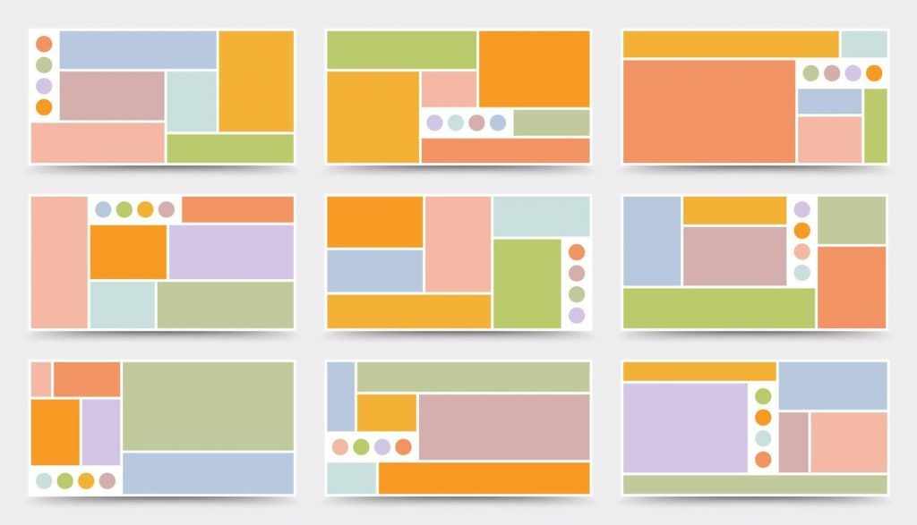

Slide 5
display: grid;
grid-template-columns: 1fr 1fr 1fr;
grid-template-rows: 1fr 1fr 1fr;

Slide 6
5x5

Slide 7


Slide 8
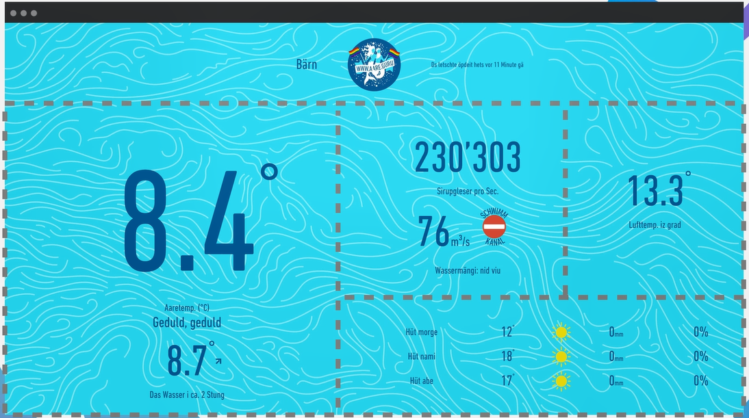

Slide 9
Flexbox
1D
Grid
2D

Slide 10
Flexbox + Grid

Slide 11
Display: grid;
Grid-template-columns: 1fr 1fr 1fr 1fr;

Slide 12
Display: grid;
Grid-template-columns: 2fr 1fr 2fr;
(Grid-template-columns: 1fr;)
Display: grid;
Grid-template-columns: 1fr 2fr 3fr;
(Grid-template-columns: 1fr;)
Display: grid;
Grid-template-columns: 1fr 2fr 3fr;
Grid-template-columns: 1fr 2fr;

Slide 13
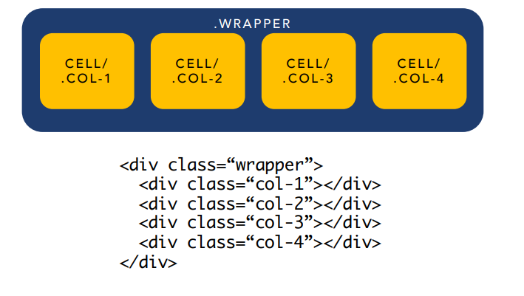

Slide 14
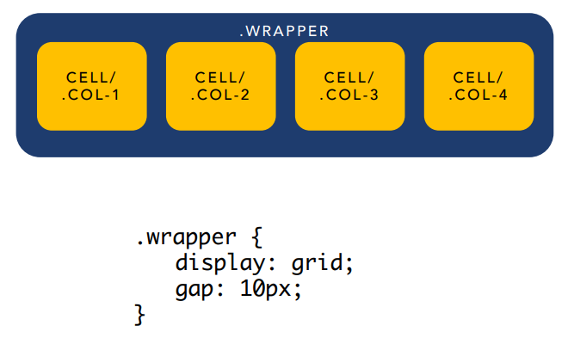

Slide 15
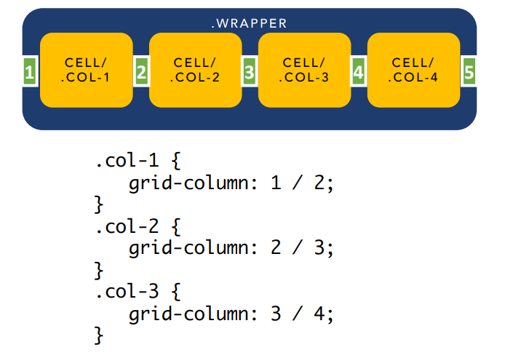

Slide 16
